Slide 1

Anemia
Jose N Galeas MD

Slide 2
Objectives
Overview of anemia
Learn about iron deficiency anemia
Learn about anemic of chronic disease
Distinguish between iron deficiency anemia and anemia of chronic disease
Discuss evidence-based management strategies
Explore Choosing Wisely recommendations

Slide 3
What is Anemia?
Anemia is defined by reduction in Hg Concentration, Hct Concentration or RBC count
Or defined as 2 standard deviations below the mean
WHO criteria is Hg < 13 in men and Hg < 12 in women - Hb <11 g/dL in pregnant women
Revised WHO criteria for patient’s with malignancy Hg < 14 in men and Hg < 12 in women

Slide 4
Signs and Symptoms
General: Fatigue, pallor, dyspnea, tachycardia
Iron deficiency: Pica, koilonychia
B12 deficiency: Neuropathy, glossitis
Hemolytic anemia: Jaundice, splenomegaly

Slide 5
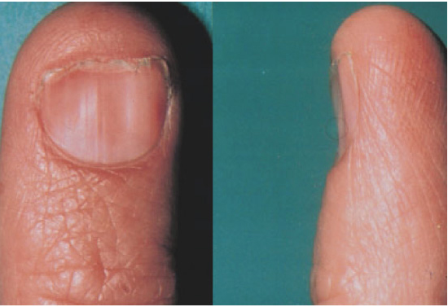
Physical Manifestation : “Spoon Nails” in Iron Deficiency

Slide 6
Kinetic Approach
Decreased RBC production
Lack of nutrients (B12, folate, iron)
Bone Marrow Disorder
Bone Marrow Suppression
Increased RBC destruction
Inherited and Acquired Hemolytic Anemias
Blood Loss

Slide 7
Morphological Approach
Microcytic (MCV < 80)
Reduced iron availability
Reduced heme synthesis
Reduced globin production
Normocytic ( 80 < MCV < 100)
Macrocytic (MCV > 100)
Liver disease, B12, folate

Slide 8
Labs
Information from good history taking and a physical exam (pallor, jaundice, etc)
CBC With Diff
Leukopenia with anemia may suggest aplastic anemia
Increased Neutrophils may suggest infection
Increased Monocytes may suggest Myelodysplasia
Thrombocytopenia may suggest hypersplenism, marrow involvement with malignancy, autoimmune destruction, folate deficiency

Slide 9
Essential Tests for Initial Anemia Workup
CBC/Diff/Platelets
Reticulocyte Count
Iron Studies (Iron, TIBC/UIBC, Ferritin)
Vitamin B12 and Folate
LDH
Haptoglobin
Bilirubin (Direct/Total)
TSH

Slide 10
Additional Tests Based on Clinical Scenarios
Hemoglobin Electrophoresis (Microcytosis, Family History)
SPEP & Immunofixation (Suspected Myeloma)
Direct Coombs (Suspected Hemolysis)
Immunoglobulins (Suspected Immune Disorder)
Erythropoietin (CKD-Related Anemia)
Copper (Nutritional Deficiency)
Flow Cytometry (Leukemia/Lymphoma Suspicion)

Slide 11
When to Order Additional Tests
Microcytic anemia with normal iron studies – Hemoglobin electrophoresis
Bone pain, high protein – SPEP/Immunofixation
Hemolysis suspicion – Direct Coombs Test
Suspected malignancy – Flow Cytometry

Slide 12
Less Common Tests
Magnesium & Phosphorus (Malnutrition, Renal Disease)
Uric Acid (Hemolysis, Malignancy)
Ultrasound Abdomen (Organomegaly, Hemolysis, Malignancy)

Slide 13
Summary of Workup Approach
• Initial Workup: - CBC, Reticulocyte Count, Iron Panel, Vitamin B12/Folate
Further Testing: - Based on symptoms and clinical suspicion
Avoid unnecessary testing without clinical indication

Slide 14
Iron Deficiency Anemia
Low Retic Count
High RDW
Low iron level
High TIBC
Low ferritin

Slide 15
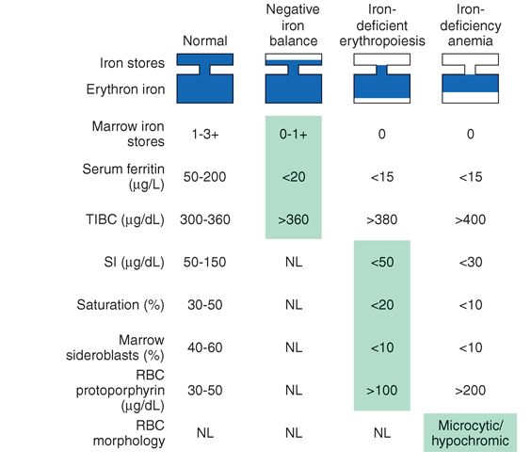
Degrees of Iron Deficiency

Slide 16
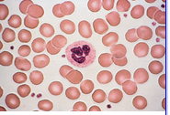
Normal Peripheral Smear

Slide 17
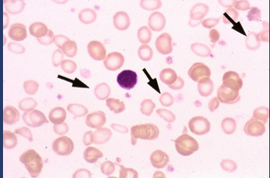
Iron Deficiency Anemia: Peripheral Smear
Microcytosis &, Hypochromic RBCs
Notes:
The arrows show that the RBCs are smaller and paler

Slide 18
Reticulocyte Count
Reticulocyte count is the percent of immature RBCs (released earlier in anemia from the marrow)
Normal levels 0.5-1.5% for non anemic stages
<1% means Inadequate Production
>/equal to 1 means increased production (hemolysis)
Corrected reticulocyte count compares anemic to non-anemic counterparts to assess response as reticulocyte count may overestimate response
Corrected Reticulocyte Count = % Retic X HCT/45

Slide 19
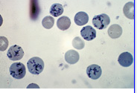
Reticulocytes

Slide 20
Reticulocyte Production Index
RPI = % reticulocytes X HCT/45 X 1/Correction Factor
Normal RPI =1
RPI < 2 = Hypoproliferative
RPI greater than/equal 2 = Hyperproliferative Disorder
Hematocrit | Correction Factor
40-45 | 1
35-39 | 1.5
25-34 | 2
15-24 | 2.5

Slide 21
So now that it’s iron deficiency….
What Causes Iron Deficiency?
Blood Loss (occult or overt): PUD, Diverticulosis, Colon Cancer
Decreased Iron Absorption: achlorhydria, atrophic gastritis, celiac disease
Foods and Medications: phytate, calcium, soy protein, polyphenols decrease iron absorption
Uncommon causes: intravascular hemolysis, pulmonary hemosiderosis, EPO, gastric bypass
Decreased Intake (rare)

Slide 22
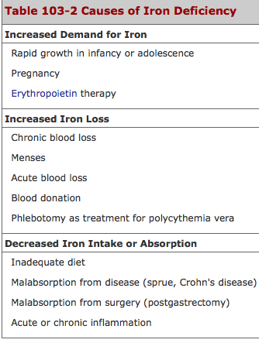

Slide 23
Who needs a GI work-up?
All men, all women without menorrhagia, women greater than 50 with menorrhagia
If UGI symptoms, EGD
If asymptomatic, colonoscopy
Women less than 50 plus menorrhagia: consider GI workup based upon symptoms

Slide 24
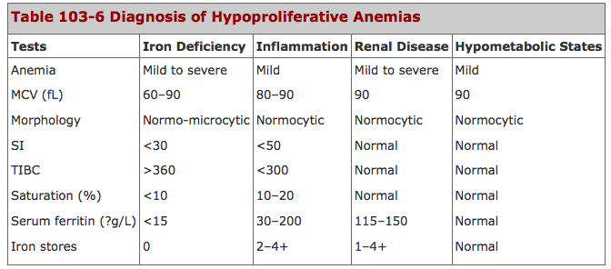

Slide 25
Gold Standard for Diagnosis
Bone Marrow Biopsy
Prussian Blue staining shows lack of iron in erythroid precursors and macrophages
However, it is invasive and costly

Slide 26
Management Strategies
Iron deficiency: Oral vs. IV iron, dietary changes
B12/Folate deficiency: Oral vs. IM supplementation
Chronic disease: Treat underlying condition, ESAs
Hemolytic anemia: Steroids, transfusions, splenectomy

Slide 27
Blood Transfusion Considerations
Indications: Hb level, symptoms
Risks and benefits
Transfusion thresholds for stable vs. critically ill patients

Slide 28
Choosing Wisely Recommendations
Avoid iron supplementation without deficiency
Limit RBC transfusions in asymptomatic patients
Assess reversible causes before long-term therapy

Slide 29
Special Considerations
Anemia in pregnancy
Anemia in the elderly
Hematologic malignancies and anemia

Slide 30
Summary and Key Takeaways
Early identification and treatment
Individualized management plans
Adherence to evidence-based guidelines

Slide 31
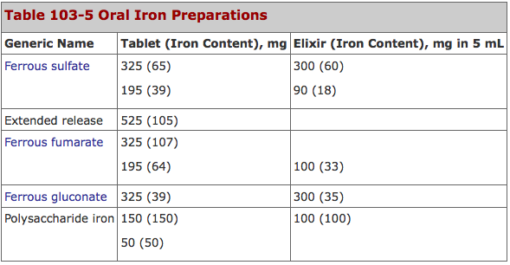
Treatment Options
Notes:
When give 200-300 mg of elemental iron, only 50-60 mg/day is absorbed

Slide 32
Iron Tolerance Test
Two iron tablets given on an empty stomach and the serum iron level measured over the next two hours.
Normal absorption will result in increase of serum iron level by 100 ug/dL
Pts may not take due to side effects (GI Side Effects)

Slide 33
Parenteral Formulations
When patient cannot tolerate PO due to side effects
When patient needs iron on an ongoing basis
Side Effect: 0.7% of iron dextran causes anaphylaxis so usually a small tester dose is given to monitor response

Slide 34
Anemia of Chronic Disease
EPO production inadequate for the degree of anemia observed or erythroid marrow responds inadequately to stimulation
Causes: inflammation, infection, tissue injury, cancer
Low serum iron, increased red cell porphyrin, transferrin 15-20%, normal to increased ferritin

Slide 35
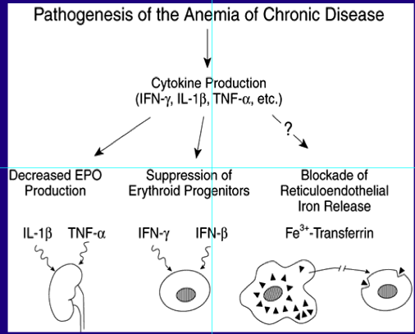
Pathophysiology

Slide 36
AICD vs. Iron Deficiency
Soluble Transferrin Receptor: elevated in cases of iron deficiency
Ferritin: elevated in anemia of chronic disease
If all else fails, Bone Marrow Biopsy
In anemia of chronic disease: macrophages contain normal/ increased iron & erythroid precursors show decreased/absent amounts of iron

Slide 37
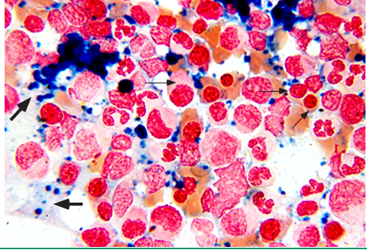
Anemia of Chronic Disease

Slide 38
Treatment
Treat the underlying cause
Treat the underlying cause
And Treat the Underlying Cause!
Consider co-existent iron deficiency as well
If underlying disease state requires it, consider EPO injection

Slide 39
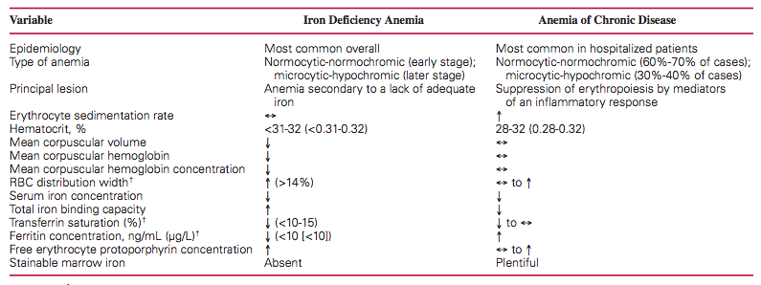
Summary

